Slide 1
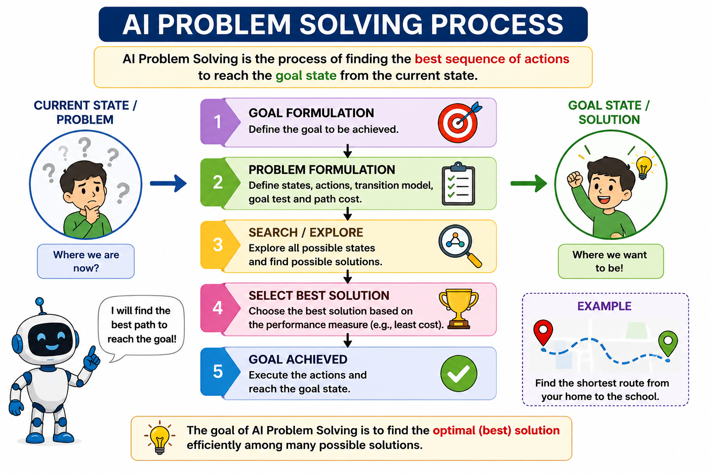

Slide 2
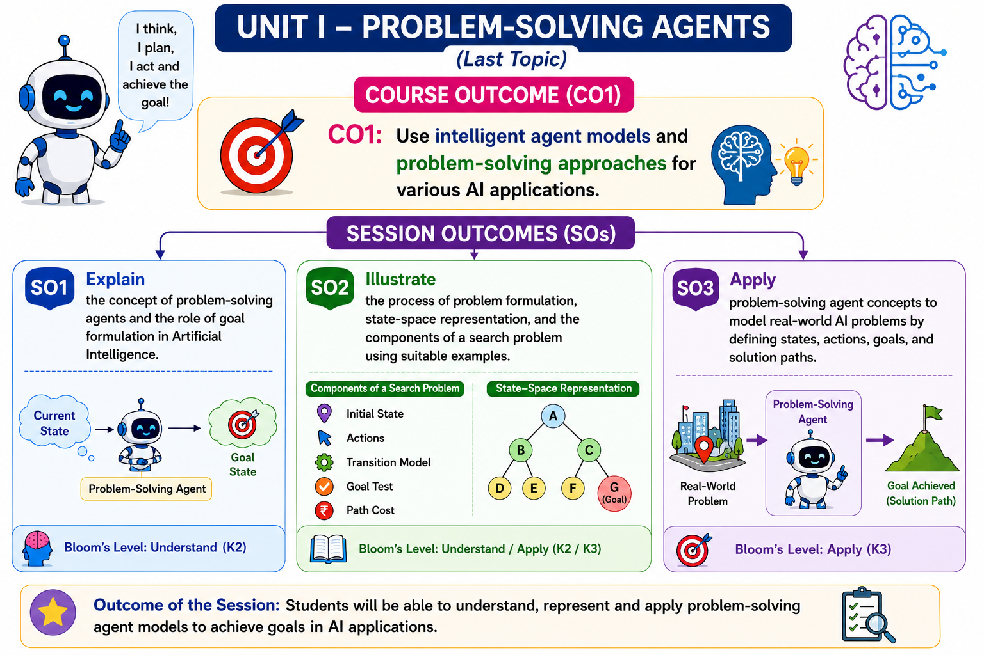

Slide 3
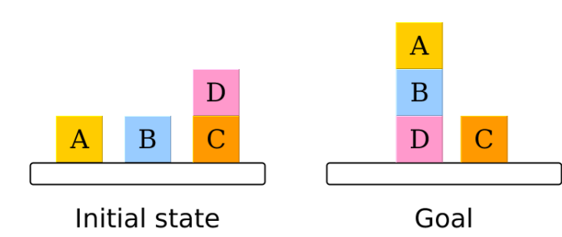
Introduction: Problem-solving
Problem-solving is commonly known as the method to reach the desired goal or finding a solution to a given situation.
In computer science, problem-solving refers to artificial intelligence techniques, including various techniques such as forming efficient algorithms, heuristics, and performing root cause analysis to find desirable solutions.
Notes:
In science and engineering, root cause analysis (RCA) is a method of problem solving used for identifying the root causes of faults or problems.

Slide 4
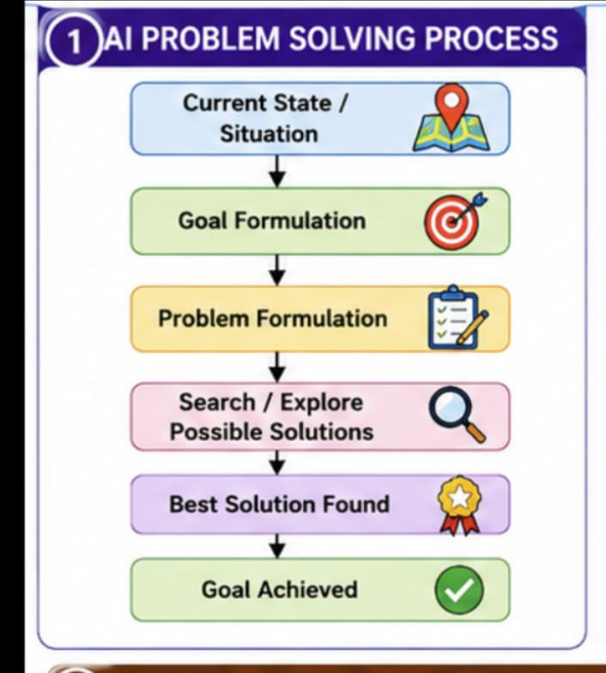

Slide 5
Problem-solving agent
The problem-solving agent performs precisely by defining problems and its several solutions.
“A problem-solving refers to a state where we wish to reach to a definite goal from a present state or condition.”
According to computer science, a problem-solving is a part of artificial intelligence which encompasses a number of techniques such as algorithms, heuristics to solve a problem.
Therefore, a problem-solving agent is a goal-driven agent and focuses on satisfying the goal.
Notes:
Heuristics: a rule or piece of information used in or enabling problem-solving or decision-making:

Slide 6
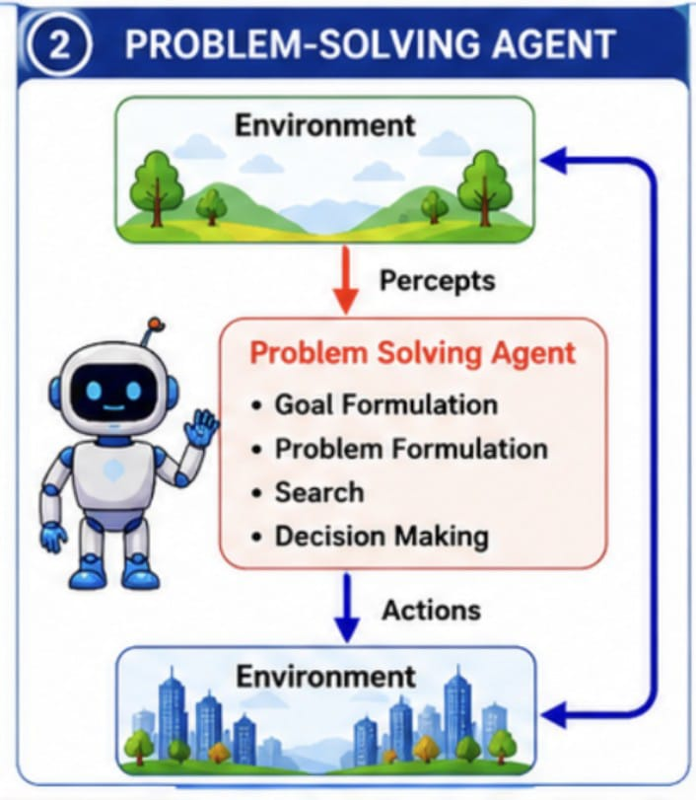

Slide 7
Steps performed by Problem-solving agent
Goal Formulation:
  First and simplest step in problem-solving. It organizes the steps/sequence required to formulate one goal out of multiple goals as well as actions to achieve that goal.
  Goal formulation is based on the current situation and the agent’s performance measure.
Problem Formulation: It is the most important step of problem-solving which decides what actions should be taken to achieve the formulated goal.
There are following five components involved in problem formulation:
  Initial State: It is the starting state or initial step of the agent towards its goal.
  Actions: It is the description of the possible actions available to the agent.
  Transition Model: It describes what each action does.
  Goal Test: It determines if the given state is a goal state.
  Path cost: It assigns a numeric cost to each path that follows the goal. The problem-solving agent selects a cost function, which reflects its performance measure. Remember, an optimal solution has the lowest path cost among all the solutions.

Slide 8
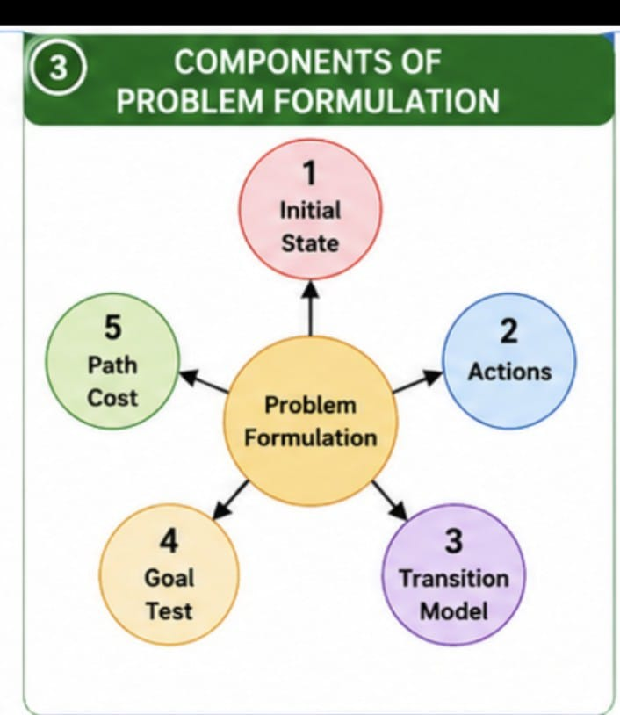

Slide 9
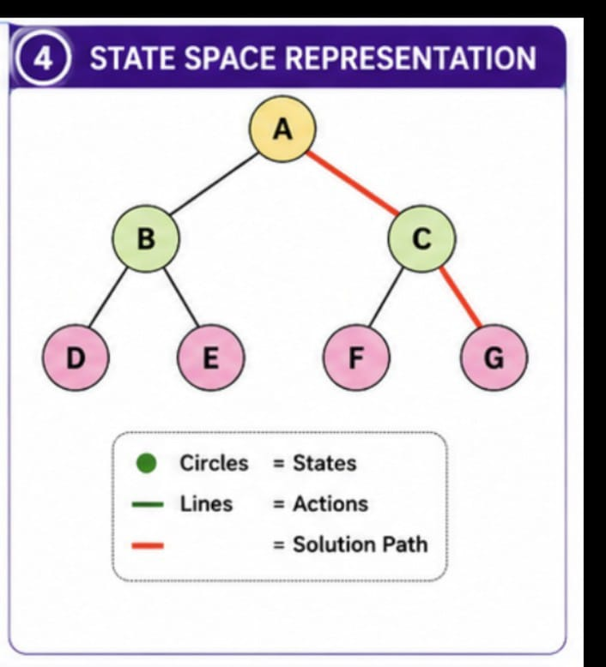

Slide 10
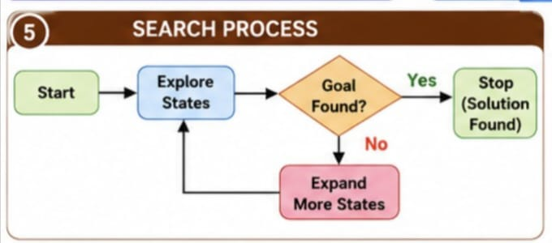

Slide 11
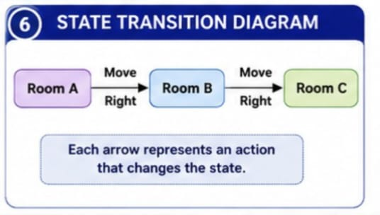

Slide 12
Example Problems
Basically, there are two types of problem approaches:
Toy Problem:
  It is a concise and exact description of the problem which is used by the researchers to compare the performance of algorithms.
  Ex: 8 Puzzle Problem, Water-Jug Problem
Real-world Problem:
  It is real-world based problems which require solutions.
  Unlike a toy problem, it does not depend on descriptions, but we can have a general formulation of the problem.
  Ex: Traveling salesperson problem(TSP)

Slide 13
Problem Solving Approach to
Typical AI problems

Slide 14
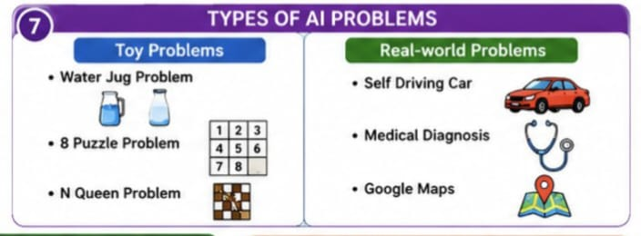

Slide 15
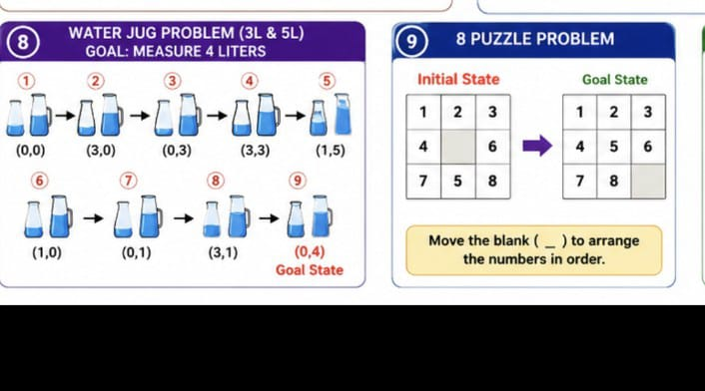

Slide 16
Water Jug Problem
The Water Jug Problem in Artificial Intelligence is a classic puzzle in AI and mathematics that focuses on optimizing the use of two or more water jugs to measure a specific quantity of water. It is a fundamental problem in the domain of optimization and decision-making. This problem comes in various forms with different jug capacities and target measurements, making it a versatile tool for learning AI problem-solving techniques.
You have a 3-liter jug and a 5-liter jug. The task is to measure exactly 4 liters of water.
The Water Jug Problem in AI involves constraints and objectives that make it a puzzle:
  Constraint 1: The jugs have limited capacities.
  Constraint 2: You can only fill or pour water between the jugs or from the source.
  Objective: The goal is to measure a specific quantity of water accurately, typically by combining and transferring water between the jugs.

Slide 17
State Space and Action Space:
In AI problem-solving, we work with a state space (all possible states) and an action space (all possible actions).
In the Water Jug Problem, the state space comprises all possible configurations of water levels in the jugs.
The action space includes the actions you can take, such as filling a jug, emptying a jug, or pouring water from one jug to another.
Initial State, Goal State, and Actions:
The initial state is where you start. In the classic scenario, this typically means both jugs are empty.
The goal state is where you want to reach, representing the desired water level, e.g., 4 liters.
Actions are the operations you can perform on the jugs, such as filling, emptying, or pouring water between them.

Slide 18
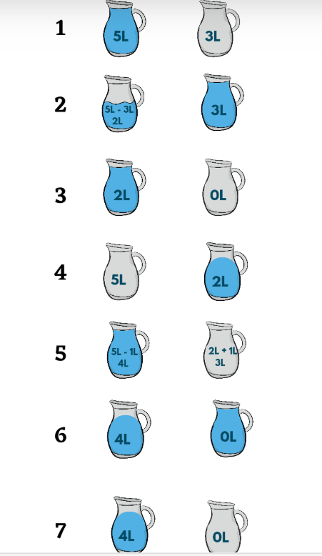
Let's consider a scenario with a 3-liter jug and a 5-liter jug, where you want to measure 4 liters of water.
  Start with both jugs empty (0, 0). Initial state
  Fill the 3-liter jug (3, 0).
  Pour water from the 3-liter jug into the 5-liter jug (0, 3).
  Fill the 3-liter jug again (3, 3).
  Pour water from the 3-liter jug into the 5-liter jug until it's full (1, 5).
  Empty the 5-liter jug (1, 0).
  Pour the remaining water from the 3-liter jug into the 5-liter jug (0, 1).
  Fill the 3-liter jug (3, 1).
  Pour water from the 3-liter jug into the 5-liter jug until it's full (0, 4).
This example illustrates how the brute-force approach can be used to solve the Water Jug Problem in AI by systematically testing various sequences of actions until the goal state is reached.

Slide 19
Consider the following example of the water jug problem using a 10-liter jug and a 7-liter jug, where the goal is to measure exactly 6 liters of water.
  Initial state: (0, 0); Goal state: (6,0)
  Start: (0, 0)
  Fill 10-liter jug: (10, 0)
  Pour from 10-liter jug to 7-liter jug: (3, 7)
  Empty 7-liter jug: (3, 0)
  Pour from 10-liter jug to 7-liter jug: (0, 3)
  Fill 10-liter jug: (10, 3)
  Pour from 10-liter jug to 7-liter jug: (6, 7)
  Empty 7-liter jug: (6, 0) Goal state reached

Slide 20
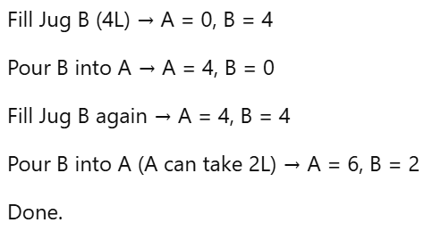
There is a 6-liter jug and a 4-liter jug with an unlimited supply of water. What is the minimum number of steps required to measure exactly 2 liters of water?
Initial state (0, 0)
Goal state (0,2)

Slide 21
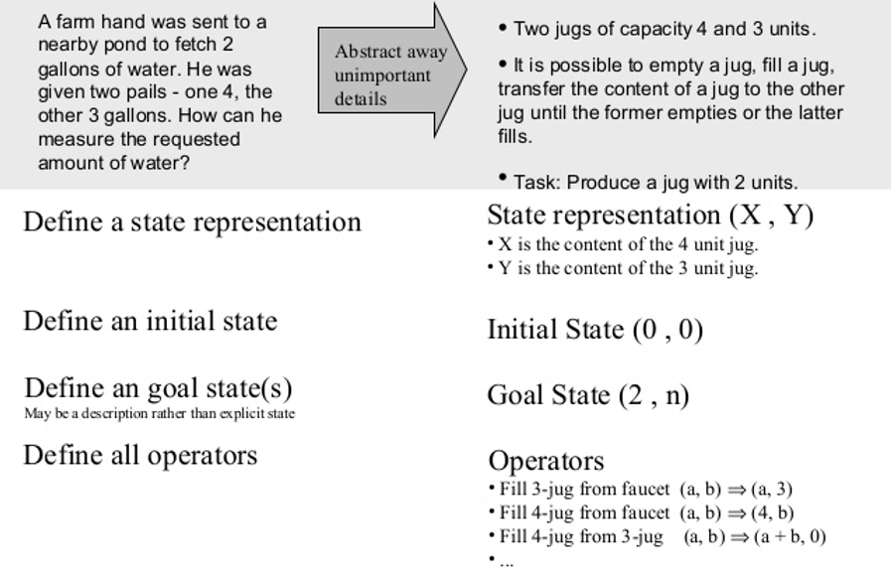
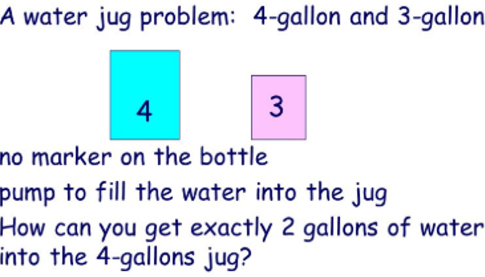
State Space representation- Ex 1 Water Jug problem

Slide 22
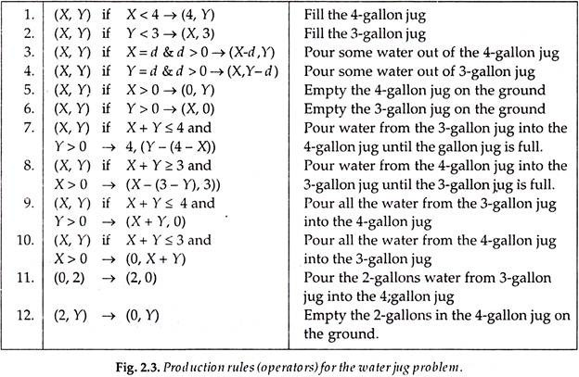
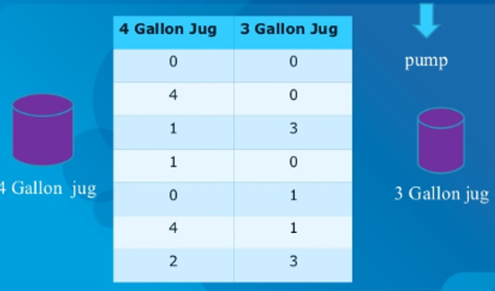
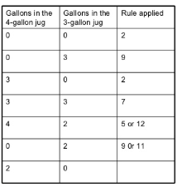

Slide 23
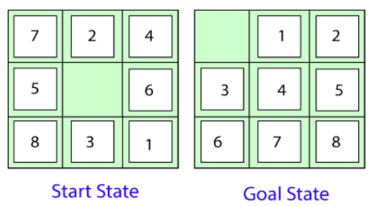
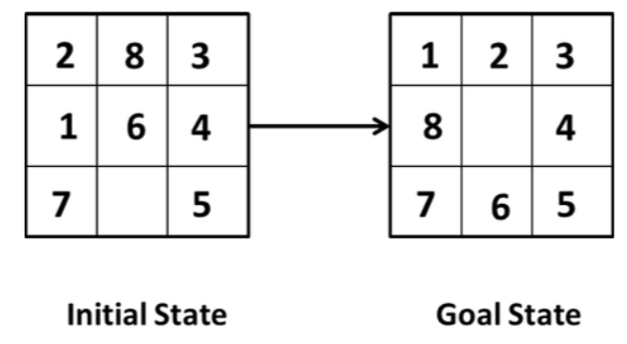
Ex 2: 8 Puzzle Problem:
Here, we have a 3×3 matrix with movable tiles numbered from 1 to 8 with a blank space. The tile adjacent to the blank space can slide into that space.
our task is to convert the current state into goal state by sliding digits into the blank space.

Slide 24
Initial state
Goal state
1 | 2 | 3
4 | 6 →
7 | 5 | 8
1 | 2 | 3
4 |  | 6
7 | ↑ 5 | 8
1 | 2 | 3
4 | 5 | 6
7 | 8
1 | 2 | 3
4 | 5 | 6
7 |  | ←8

Slide 25
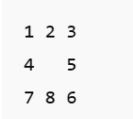
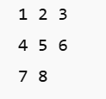
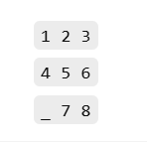
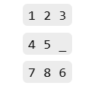
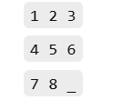
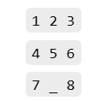

Initial state Goal state
Move 5 left Move 6 up Move 8 right Move 7 right

Slide 26
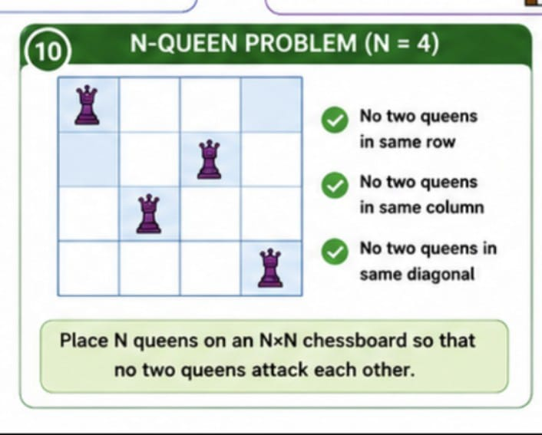

Slide 27
N Queens Problem
Given an integer n, the task is to find the solution to the n-queens problem, where n queens are placed on an n*n chessboard such that no two queens can attack each other.
No two queens can share the same row, column or diagonal.
A queen will attack another queen if it is placed in horizontal, vertical or diagonal points in its way.
The most popular approach for solving the N Queen puzzle is Backtracking.
The N Queen is the problem of placing N chess queens on an N×N chessboard so that no two queens attack each other.

Slide 28
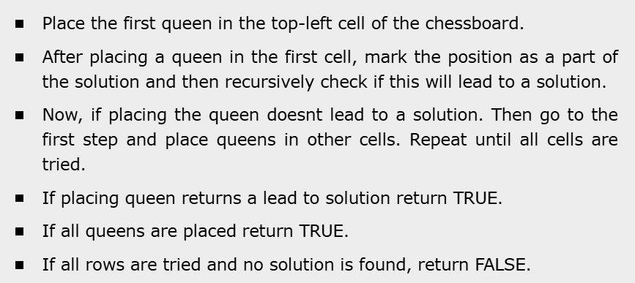
Procedure

Slide 29
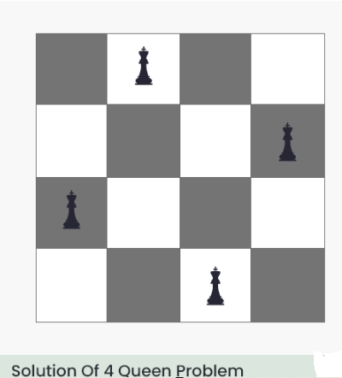
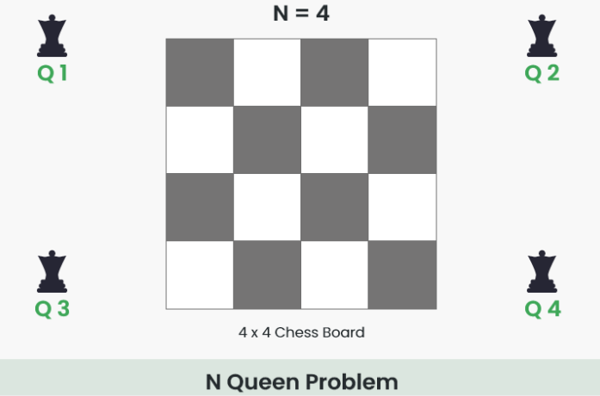
Notes:
Input: 4
Output: [2, 4, 1, 3] / [3, 1, 4, 2]

Slide 30
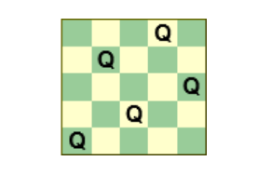
Chessboard size 5×5

Slide 31
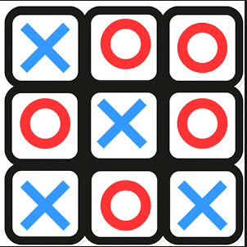
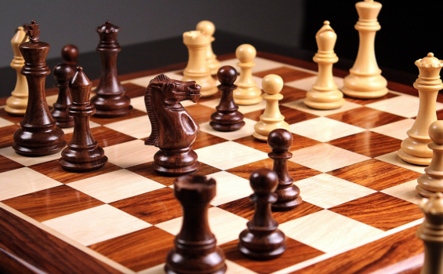
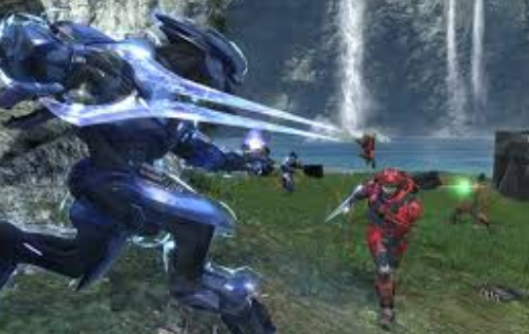
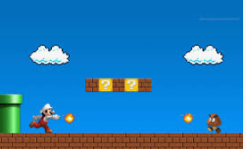
Problems,
Problem Spaces and Search

Slide 32
To build a system to solve a particular problem
To solve the problem of building a system, you should take the following steps:
  1. Define the problem accurately -including detailed specifications and what constitutes a suitable solution.
  2. Analyze the problem carefully, for some features may have a central affect on the chosen method of solution.
  3. Segregate and represent the background knowledge needed to solve the problem.
  4. Choose the best problem-solving techniques and apply it to the particular problem.

Slide 33
Problem solving
We want:
  To automatically solve a problem
We need:
  A representation of the problem
  Algorithms that use some strategy to solve the problem defined in that representation

Slide 34
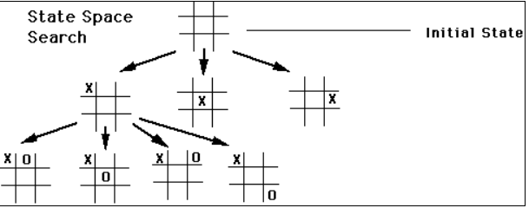
Defining the Problem as a State Space Search
General:
  State space: a problem is divided into a set of resolution steps from the initial state to the goal state
  Reduction to sub-problems: a problem is arranged into a hierarchy of sub-problems
Specific:
  Game resolution
  Constraints satisfaction

Slide 35
State Space Search
Initial state, actions, and transition model together define the state-space of the problem implicitly.
State-space of a problem is a set of all states which can be reached from the initial state followed by any sequence of actions.
The state-space forms a directed map or graph where nodes are the states, links between the nodes are actions, and the path is a sequence of states connected by the sequence of actions.
Search: It identifies all the best possible sequence of actions to reach the goal state from the current state. It takes a problem as an input and returns solution as its output.
Solution: It finds the best algorithm out of various algorithms, which may be proven as the best optimal solution.
Execution: It executes the best optimal solution from the searching algorithms to reach the goal state from the current state

Slide 36
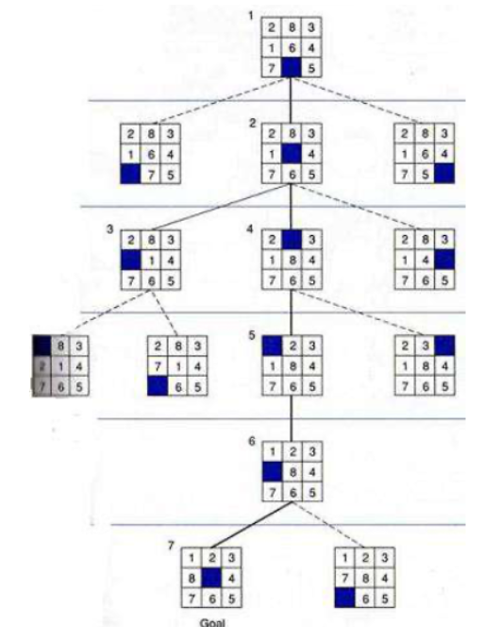

Slide 37
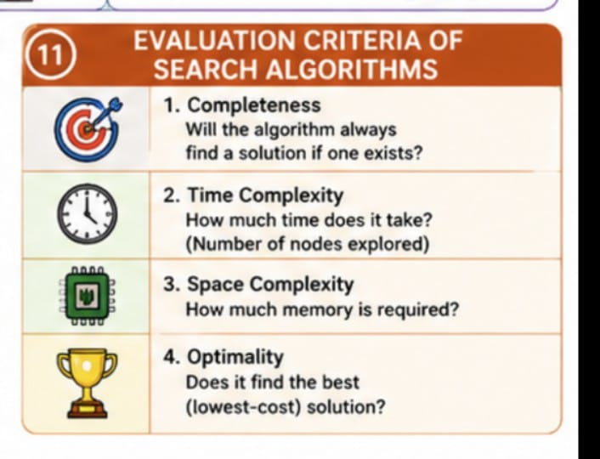

Slide 38
Problem definitions
A problem is defined by its ‘elements’ and their ‘relations’.
To provide a formal description of a problem, we need to do the following:
  a. Define a state space that contains all the possible configurations of the relevant objects, including some impossible ones.
  b. Specify one or more states that describe possible situations, from which the problem solving process may start. These states are called initial states.
  c. Specify one or more states that would be acceptable solution to the problem- goal states.
  D Specify a set of rules that describe the actions (operators) available, in combination with an appropriate control strategy, to move through the problem space until a path from an initial state to a goal state is found. This process is known as ‘search’.

Slide 39
States
A problem is defined by its elements and their relations.
In each instant of the resolution of a problem, those elements have specific descriptors (How to select them?) and relations.
A state is a representation of those elements in a given moment.
Two special states are defined:
  Initial state (starting point)
  Final state (goal state)

Slide 40
State space
The state space is the set of all states reachable from the initial state.
It forms a graph (or map) in which the nodes are states and the arcs between nodes are actions.
A path in the state space is a sequence of states connected by a sequence of actions.
The solution of the problem is part of the map formed by the state space.

Slide 41
State modification: successor function
A successor function is needed to move between different states.
A successor function is a description of possible actions, a set of operators. It is a transformation function on a state representation, which convert it into another state.
The successor function defines a relation of accessibility among states.
Representation of the successor function:
  Conditions of applicability
  Transformation function

Slide 42
Problem solution
A solution in the state space is a path from the initial state to a goal state or, sometimes, just a goal state.
Path/solution cost: function that assigns a numeric cost to each path, the cost of applying the operators to the states
Solution quality is measured by the path cost function, and an optimal solution has the lowest path cost among all solutions.
Solutions: any, an optimal one, all. Cost is important depending on the problem and the type of solution sought.

Slide 43
More concrete problem definition
A state space
Choose a representation
An initial state
Choose an element from the representation
A goal state
Create goal_function(state) such that TRUE is returned upon reaching goal
A function defining state transitions
successor_function(state_{i}) =
{<action_{a}, state_{a}>, <action_{b}, state_{b}>, …}
A function defining the “cost” of a state sequence
cost (sequence) = number

Slide 44
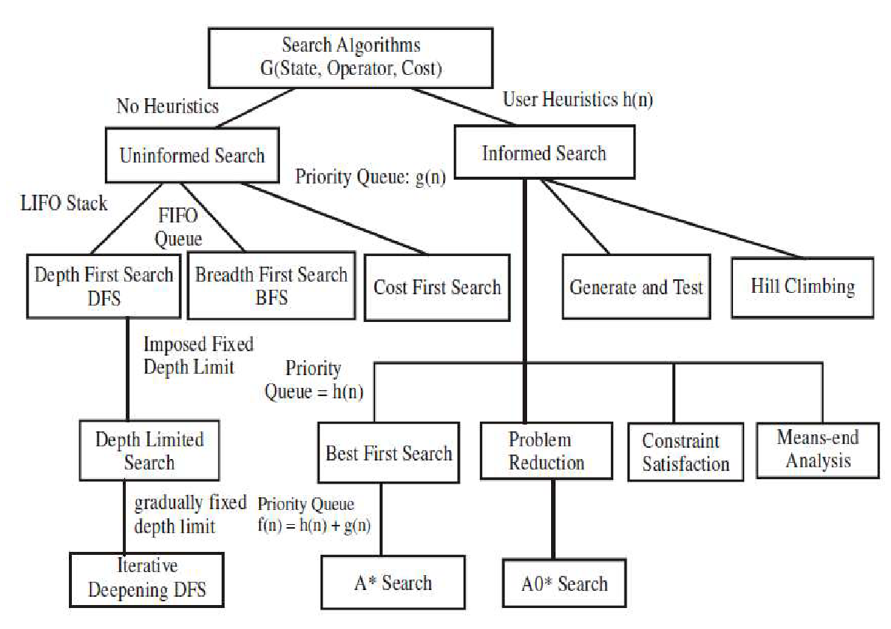
Different search algorithms

Slide 45
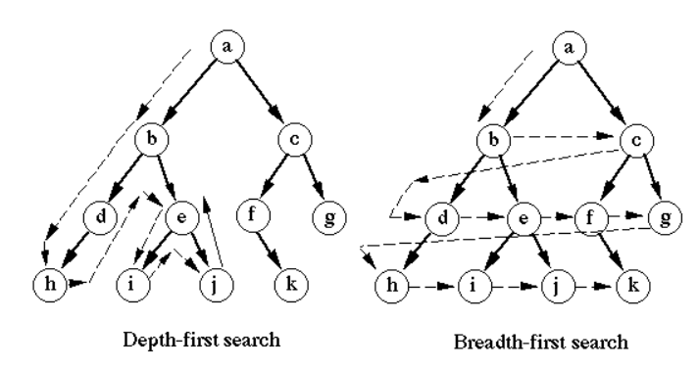

Slide 46
Search strategies
A strategy is defined by picking the order of node expansion
  Open nodes:
    Generated, but not yet explored
    Explored, but not yet expanded
  Closed nodes:
    Explored and expanded
Strategies are evaluated along the following dimensions:
  Completeness – does it always find a solution if one exists?
  Time complexity – number of nodes generated/expanded
  Space complexity – maximum nodes in memory
  Optimality – does it always find a least-cost solution?

